Slide 1


Control Flow : if, elif, else

Slide 2

Kurnia Anwar Ra’if
A Highly-motivated Data Scientist
Senior Data & AI Platform - PT. Mastersystem Infotama Tbk
Data Scientist @ PT. KitaLulus International
Data Scientist @ PT. Sharing Vision– BRI Consultant
Software Engineering @ PT. AILIMA Geothermal
Mentor DS/BI/AI-ML - @ Dibimbing.id

Slide 3

Outline :
Comparison & logical operators
Conditional statements (if, elif, else)
Nested conditions
User input + logic combo
Age or Grade Classifier

Slide 4
Remainder

Slide 5
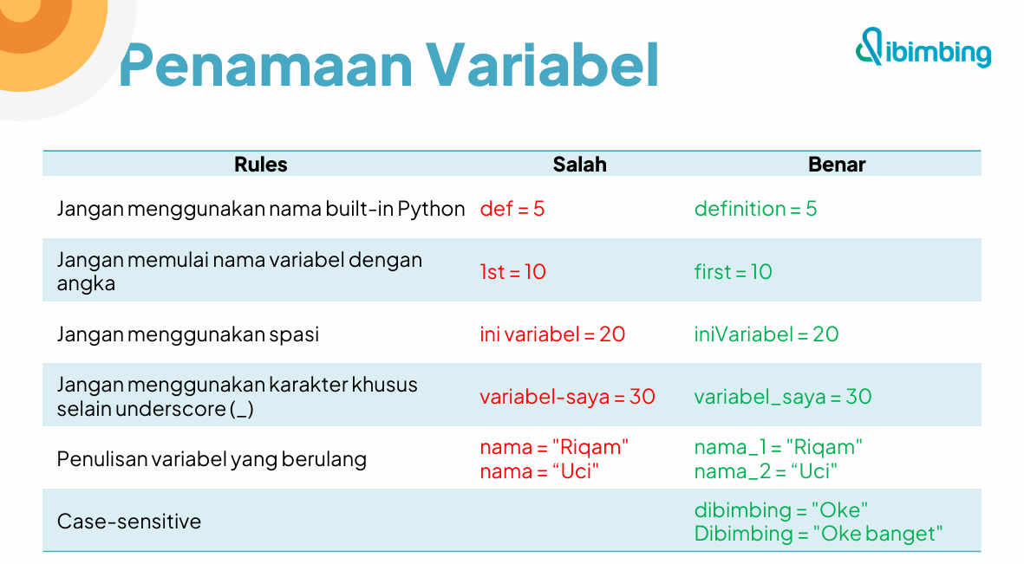


Slide 6
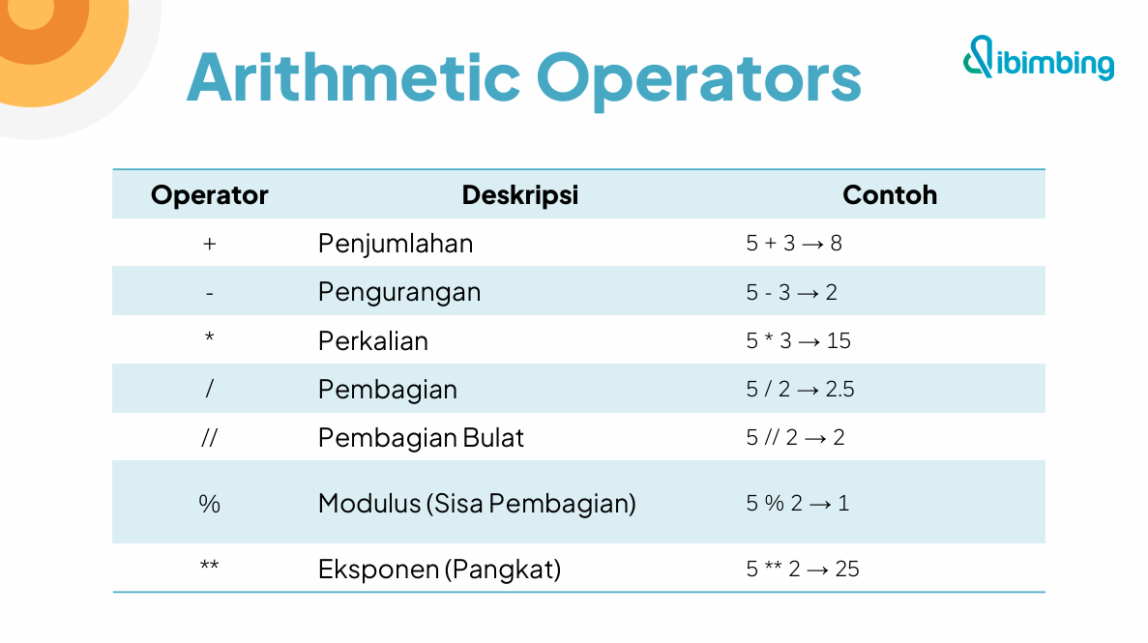

Slide 7
Control Flow

Slide 8
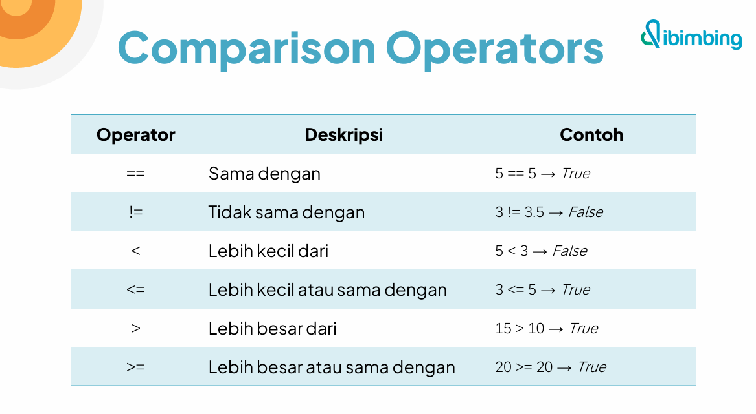

Slide 9
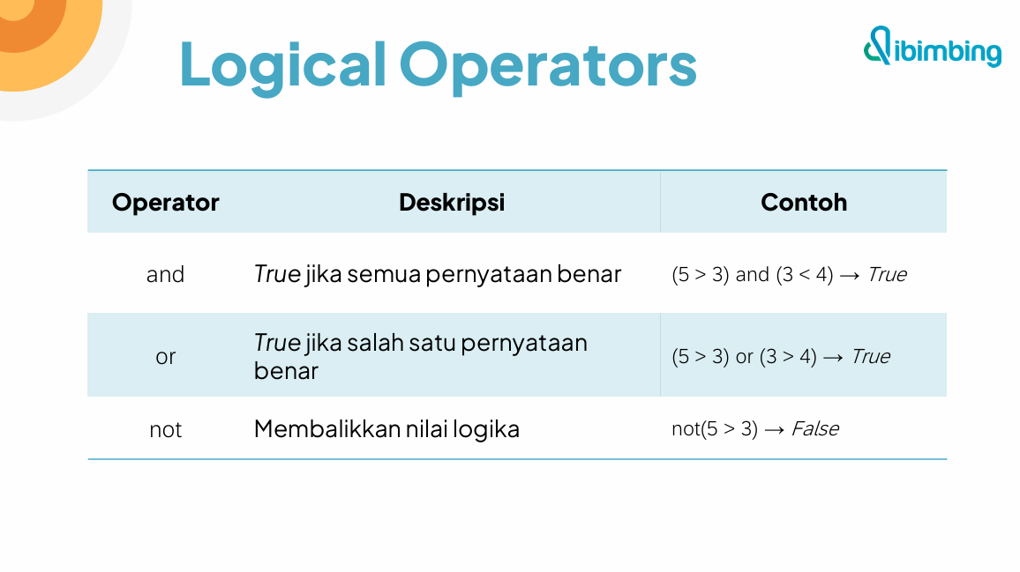

Slide 10
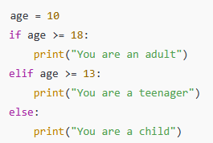
Conditional Statements (if, elif, else)
The if statement checks whether a condition is True. If it is, the indented block of code under it will be executed.
elif (else if) Used to check another condition if the previous if condition was False. You can have multiple elif blocks.
The else block is executed when none of the previous conditions are True.
Summary :
- if: checks the first condition
- elif: checks additional conditions
- else: runs if none of the above conditions are true
These are essential for building decision-making logic in your Python programs.

Slide 11
Hands on

Slide 12
Nested Conditions
Nested condition adalah conditional statement yang berada di dalam conditional statement lainnya. Artinya, setelah suatu kondisi if bernilai True, di dalam blok tersebut kita bisa menambahkan kondisi if lagi untuk pengecekan tambahan.
Kapan digunakan nested condition?
Saat keputusan bersifat bertingkat.
Saat hasil dari kondisi pertama mempengaruhi logika kondisi kedua.
Contoh nyata:
Jika umur ≥ 18 → cek apakah sudah punya SIM atau belum.
Jika skor ≥ 75 → cek apakah lulus ujian praktikum atau tidak.

Slide 13
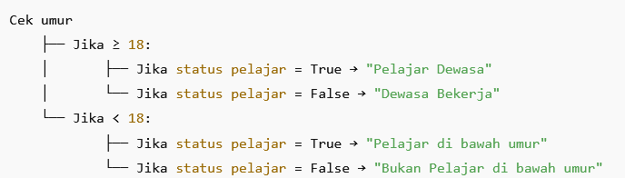
Nested Conditions
Perlu diingat:
Nested terlalu dalam bisa membuat kode sulit dibaca (deep nesting).
Bisa digabungkan dengan logical operator untuk mengurangi kedalaman nesting.

Slide 14
Hands on

Slide 15
Brief Assignment

Slide 16
Brief Assignment :
Buat program untuk menentukan kategori BMI berdasarkan input berat (kg) dan tinggi (m), carilah referensi rentang nilai kategori BMI yang valid. Jawaban Harus memenuhi :
if,elif,else
Nested condition, logical operator & comparison

Slide 17


Thank you
https://www.linkedin.com/in/anwaraif/
kurniafreelancer@gmail.com

